Slide 1
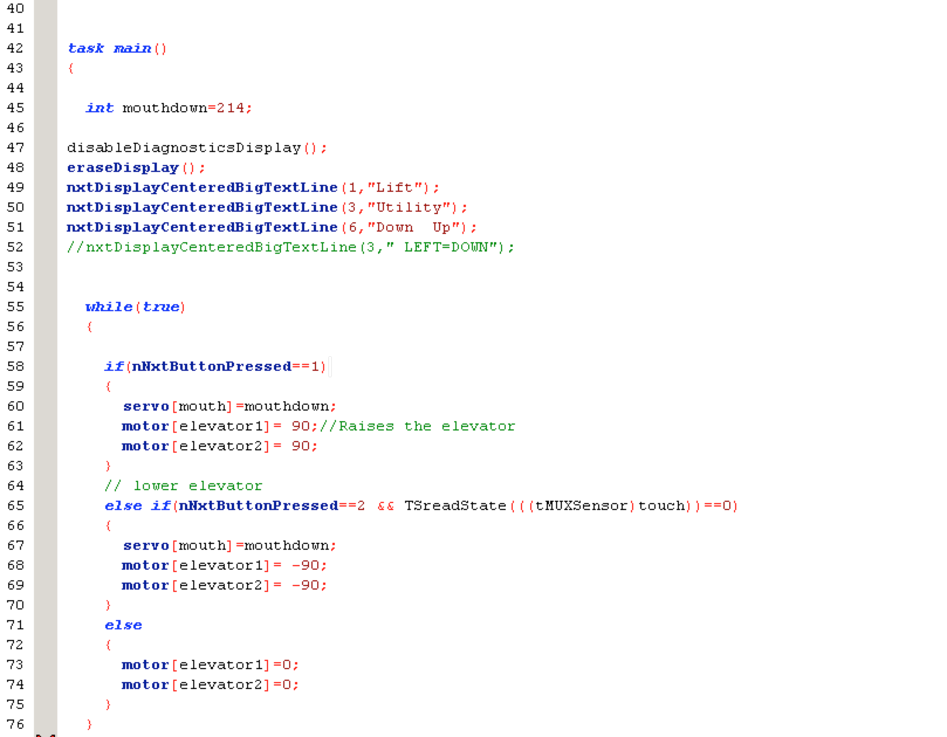
7350 Team Watt NXT, Edison New Jersey
Title
Page Number
Agenda: Test the Elevator Mechanism
Problem: We needed a quick way to test the Scissor Lift during competition quickly in between matches in order to test and quickly adjust the lift if needed
Solution: We have coded a control software that allows us to directly raise and lower the lift using the NXT buttons. It allows us to test the lift in between matches without needing a computer, and allows us to make the changes we need to.
Accomplishment: Coded a utility so that we can test the scissor lift directly on the NXT without the need for an external computer
Recorded by Vishal Sriram Sign Date: March 14, 2015
Time Start Stop

